Slide 1
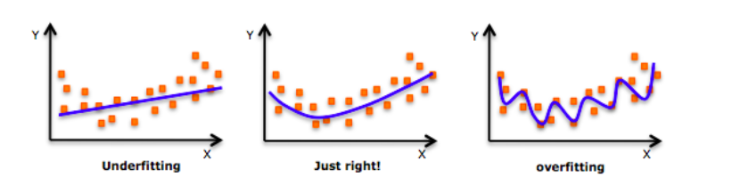
Bigger Network
Train Longer
More training data
Regularization L1/L2
Dropout
Data Augmentation
Early Stopping

Slide 2
L1/L2 Regularization
Simple NN with No Regularization
model.compile (loss='categorical_crossentropy', optimizer='adam', metrics=['accuracy’])
history = model.fit(x_train, y_train, nb_epoch=epochs, batch_size=batch_size, validation_data=(x_test, y_test))
L2 Regularization with lambda=0.0001
Dense (output_dim=hidden1_num_units, input_dim=input_num_units, activation='relu', kernel_regularizer=regularizers.l2(0.0001))
L1 Regularization with lambda=0.0001
Dense (output_dim=hidden1_num_units, input_dim=input_num_units, activation='relu', kernel_regularizer=regularizers.l1(0.0001))

Slide 3
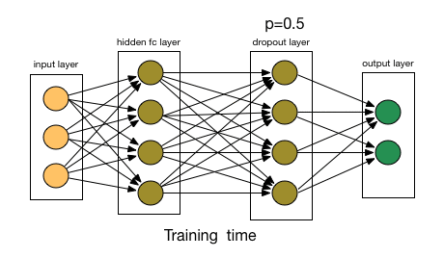
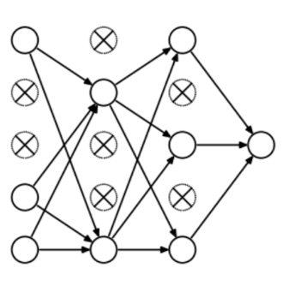
Dropout
model = Sequential()
model.add(Dense(60, input_shape=(60,), activation='relu', kernel_constraint=MaxNorm(3)))
model.add(Dropout(0.2))
model.add(Dense(30, activation='relu', kernel_constraint=MaxNorm(3)))
model.add(Dropout(0.2))
model.add(Dense(1, activation='sigmoid'))

Slide 4
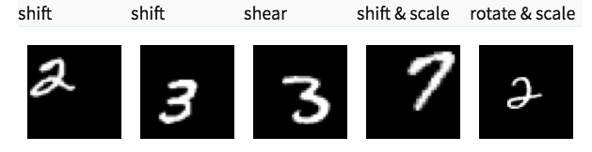
Data Augmentation

Slide 5
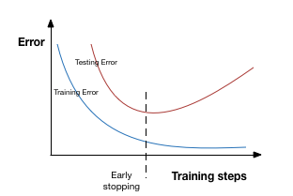
Early Stopping

